Slide 1

Adama Science and Technology University
Data structures and Algorithm
(week 3-4)

Slide 2
Searching

Slide 3
Problem: Search
We are given a list of records.
Each record has an associated key.
Give efficient algorithm for searching for a record containing a particular key.

Slide 4
Search searching is looking for some particular data element from data structure.
[ 0 ]
[ 1 ]
[ 2 ]
[ 3 ]
[ 4 ]
[ 700 ]
…
Number 701466868
Number 281942902
Number 233667136
Number 580625685
Number 506643548
Number 155778322
Each record in list has an associated key.
In this example, the keys are ID numbers.
Given a particular key, how can we efficiently retrieve the record from the list?
Number 580625685

Slide 5
Sequential Search
In this, the list or array is traversed sequentially and every element is checked.
Step through array of records, one at a time.
Look for record with matching key.
Search stops when
  record with matching key is found
  or when search has examined all records without success.

Slide 6
Pseudocode for Seq. Search
int arr[]={89,2,67,37,72,17,4};
int n=sizeof(arr)/sizeof(arr[0]);
int found=0;
int key=37;
for(int i=0;i<n;i++)
{
if(arr[i]==key)
found=1;
}
return found;

Slide 7
Serial Search Analysis
What are the worst and average case running times for serial search?
We must determine the O-notation for the number of operations required in search.
Number of operations depends on n, the number of entries in the list.

Slide 8
Worst Case Time for Serial Search
For an array of n elements, the worst case time for serial search requires n array accesses: O(n).
Consider cases where we must loop over all n records:
  desired record appears in the last position of the array
  desired record does not appear in the array at all

Slide 9
Average Case for Seq. Search
Assumptions:
  All keys are equally likely in a search
  We always search for a key that is in the array
Example:
We have an array of 10 records.
If search for the first record, then it requires 1 array access; if the second, then 2 array accesses. etc.
The average of all these searches is:
  (1+2+3+4+5+6+7+8+9+10)/10 = 5.5

Slide 10
Average Case Time for Seq. Search
Generalize for array size n.
Expression for average-case running time:
(1+2+…+n)/n = n(n+1)/2n = (n+1)/2
Therefore, average case time complexity for serial search is O(n).

Slide 11
Binary Search
These algorithm are specifically designed for searching in sorted data element.
It assumes the data is sorted and it also uses divide and conquer strategy.
Binary search algorithm worst case O(log n) and best case O(1) when the central index would directly match the desired value.
Assume that we are given an array of records that is sorted. For instance:
  an array of records with integer keys sorted from smallest to largest (e.g., ID numbers), or
  an array of records with string keys sorted in alphabetical order (e.g., names).

Slide 12
Binary Search Pseudocode
…
if(size == 0)
found = false;
else {
middle = index of approximate midpoint of array segment;
if(target == a[middle])
target has been found!
else if(target < a[middle])
search for target in area before midpoint;
else
search for target in area after midpoint;
}
…

Slide 13
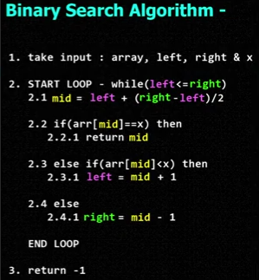

Slide 14
Binary Search
Example: sorted array of integer keys. Target=7.
[ 0 ]
[ 1 ]
[ 2 ]
[ 3 ]
[ 4 ]
[ 5 ]
[ 6 ]
3
6
7
11
32
33
53

Slide 15
Binary Search
Example: sorted array of integer keys. Target=7.
[ 0 ]
[ 1 ]
[ 2 ]
[ 3 ]
[ 4 ]
[ 5 ]
[ 6 ]
3
6
7
11
32
33
53
Find approximate midpoint

Slide 16
Binary Search
Example: sorted array of integer keys. Target=7.
[ 0 ]
[ 1 ]
[ 2 ]
[ 3 ]
[ 4 ]
[ 5 ]
[ 6 ]
3
6
7
11
32
33
53
Is 7 = midpoint key? NO.

Slide 17
Binary Search
Example: sorted array of integer keys. Target=7.
[ 0 ]
[ 1 ]
[ 2 ]
[ 3 ]
[ 4 ]
[ 5 ]
[ 6 ]
3
6
7
11
32
33
53
Is 7 < midpoint key? YES.

Slide 18
Binary Search
Example: sorted array of integer keys. Target=7.
[ 0 ]
[ 1 ]
[ 2 ]
[ 3 ]
[ 4 ]
[ 5 ]
[ 6 ]
3
6
7
11
32
33
53
Search for the target in the area before midpoint.

Slide 19
Binary Search
Example: sorted array of integer keys. Target=7.
[ 0 ]
[ 1 ]
[ 2 ]
[ 3 ]
[ 4 ]
[ 5 ]
[ 6 ]
3
6
7
11
32
33
53
Find approximate midpoint

Slide 20
Binary Search
Example: sorted array of integer keys. Target=7.
[ 0 ]
[ 1 ]
[ 2 ]
[ 3 ]
[ 4 ]
[ 5 ]
[ 6 ]
3
6
7
11
32
33
53
Target = key of midpoint? NO.

Slide 21
Binary Search
Example: sorted array of integer keys. Target=7.
[ 0 ]
[ 1 ]
[ 2 ]
[ 3 ]
[ 4 ]
[ 5 ]
[ 6 ]
3
6
7
11
32
33
53
Target < key of midpoint? NO.

Slide 22
Binary Search
Example: sorted array of integer keys. Target=7.
[ 0 ]
[ 1 ]
[ 2 ]
[ 3 ]
[ 4 ]
[ 5 ]
[ 6 ]
3
6
7
11
32
33
53
Target > key of midpoint? YES.

Slide 23
Binary Search
Example: sorted array of integer keys. Target=7.
[ 0 ]
[ 1 ]
[ 2 ]
[ 3 ]
[ 4 ]
[ 5 ]
[ 6 ]
3
6
7
11
32
33
53
Search for the target in the area after midpoint.

Slide 24
Binary Search
Example: sorted array of integer keys. Target=7.
[ 0 ]
[ 1 ]
[ 2 ]
[ 3 ]
[ 4 ]
[ 5 ]
[ 6 ]
3
6
7
11
32
33
53
Find approximate midpoint.
Is target = midpoint key? YES.

Slide 25
Binary Search Implementation
int arr[] = { 1, 3, 4, 6, 7, 8, 10, 13, 14, 18, 19, 21, 24, 37, 40, 45, 71 };
int n=sizeof(arr)/sizeof(arr[0]);
int first=0;
int last=n-1;
int key=32;
int found=0;
while(first<=last)
{
int mid=(first+last)/2;
if(arr[mid]==key)
{
found=1;
break; }
else if(key < arr[mid])
{
last=mid-1;
}
else if(key > arr[mid])
{
first=mid+1;
}
}
return found;

Slide 26
Simple Sorting Algorithms

Slide 27
Bubble sort
This sort is the simplest sorting algorithm that works by repeatedly swapping the adjacent elements if they are in wrong order.
Compare each element (except the last one) with its neighbor to the right
  If they are out of order, swap them
  This puts the largest element at the very end
  The last element is now in the correct and final place
Compare each element (except the last two) with its neighbor to the right
  If they are out of order, swap them
  This puts the second largest element next to last
  The last two elements are now in their correct and final places
Compare each element (except the last three) with its neighbor to the right
  Continue as above until you have no unsorted elements on the left

Slide 28
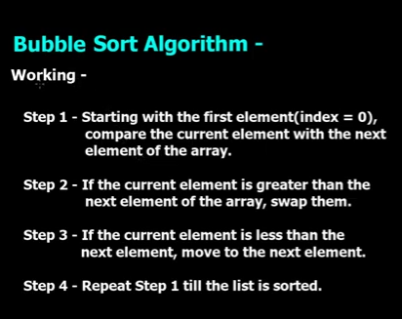

Slide 29
Example of bubble sort
7
2
8
5
4
2
7
5
4
8
2
5
4
7
8
2
4
5
7
8
2
7
8
5
4
2
7
5
4
8
2
5
4
7
8
2
4
5
7
8
2
7
8
5
4
2
5
7
4
8
2
4
5
7
8
(done)
2
7
5
8
4
2
5
4
7
8
2
7
5
4
8

Slide 30
Code for bubble sort
int arr[]={89,2,67,37,72,17,4};
int n=sizeof(arr)/sizeof(arr[0]);
for(int i=n-1;i>=0;i--)
{
for(int j=0;j<=i;j++)
{
if(arr[j+1]<arr[j])
{
int temp =arr[j+1];
arr[j+1]=arr[j];
arr[j]=temp;
}
}
}

Slide 31
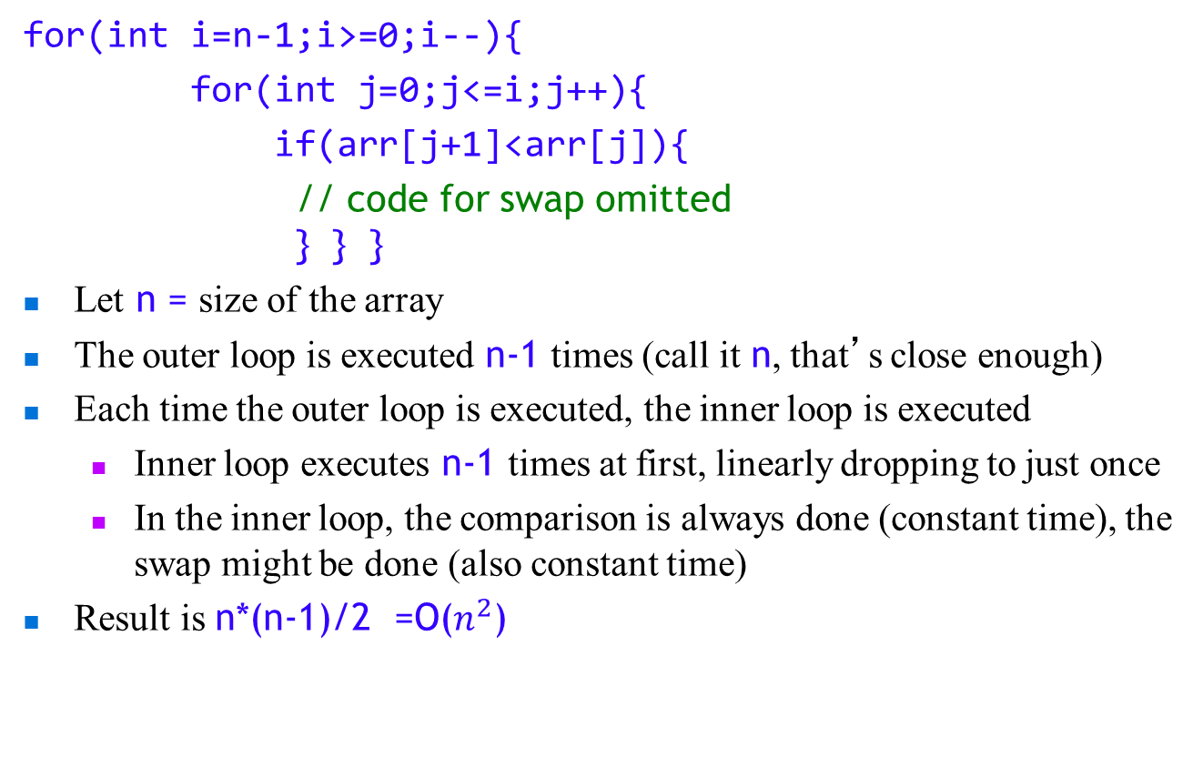
Analysis of bubble sort

Slide 32
Selection sort
This sort is a sorting algorithm, specifically an in-place comparison sort and it divides the input list in two parts sorted and unsorted.
Given an array of length n,
  Search elements 0 through n-1 and select the smallest
    Swap it with the element in location 0
  Search elements 1 through n-1 and select the smallest
    Swap it with the element in location 1
  Search elements 2 through n-1 and select the smallest
    Swap it with the element in location 2
  Search elements 3 through n-1 and select the smallest
    Swap it with the element in location 3
  Continue in this fashion until there’s nothing left to search

Slide 33
Example and analysis of selection sort
The selection sort might swap an array element with itself--this is harmless, and not worth checking for
Analysis:
  The outer loop executes n-1 times
  The inner loop executes about n/2 times on average (from n to 2 times)
  Work done in the inner loop is constant (swap two array elements)
  Time required is roughly (n-1)*(n/2)
  You should recognize this as O(n²)
7
2
8
5
4
2
7
8
5
4
2
4
8
5
7
2
4
5
8
7
2
4
5
7
8

Slide 34
Code for selection sort
int arr[]={89,2,67,37,72,17,4};
int n=sizeof(arr)/sizeof(arr[0]);
for(int i=0;i<n;i++)
{
int small=i;
for(int j=i+1;j<n;j++)
{
if(arr[j]<arr[small])
{
small=j;
}
}
int temp =arr[i];
arr[i]=arr[small];
arr[small]=temp;
}

Slide 35
Insertion sort
The outer loop of insertion sort is:
for (outer = 1; outer < n; outer++) {...}
The invariant is that all the elements to the left of outer are sorted with respect to one another
  For all i < outer, j < outer, if i < j then a[i] <= a[j]
  This does not mean they are all in their final correct place; the remaining array elements may need to be inserted
  When we increase outer, a[outer-1] becomes to its left; we must keep the invariant true by inserting a[outer-1] into its proper place
  This means:
    Finding the element’s proper place
    Making room for the inserted element (by shifting over other elements)
    Inserting the element

Slide 36
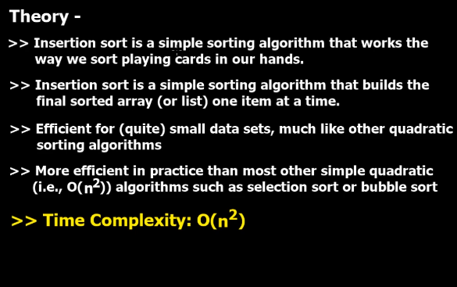

Slide 37
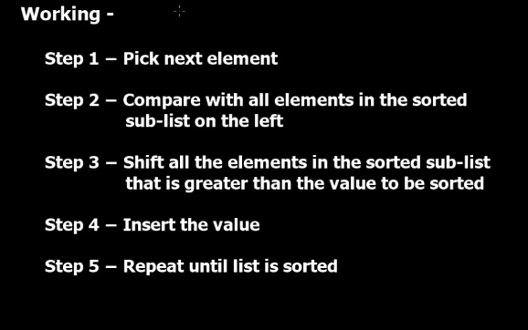

Slide 38
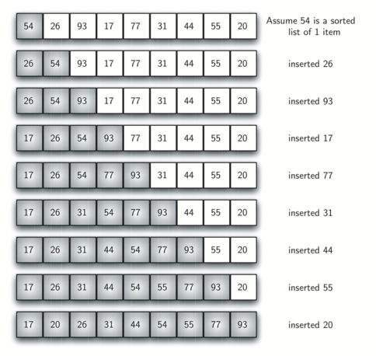
Example insertion sort

Slide 39
Code for Insertion Sort
//Insertion sort
int arr[]={89,2,67,37,72,17,4};
int n=sizeof(arr)/sizeof(arr[0]);
for(int i=1;i<n;i++)
{
for(int j=i;j>0;j--)
{
if(arr[j]<arr[j-1])
{
int temp =arr[j];
arr[j]=arr[j-1];
arr[j-1]=temp;
}
}
}

Slide 40
Analysis of insertion sort
We run once through the outer loop, inserting each of n elements; this is a factor of n
On average, there are n/2 elements already sorted
  The inner loop looks at (and moves) half of these
  This gives a second factor of n/4
Hence, the time required for an insertion sort of an array of n elements is proportional to n²/4
Discarding constants, we find that insertion sort is O(n²)

Slide 41
THE END

